Slide 1
中期汇报
第六小组 简旭峰 严云鹤 凌梓超
2022年4月27日

Slide 2
TABLE OF CONTENTS
01
技术选型
02
进度展示
03
未来计划

Slide 3
01
技术选型
What we chose to do for requirements?

Slide 4
我们的选择是…….
B/S Model
Reactor Server
多线程Reactor 模型服务器，支持HTTP协议
参考教务系统的呈现模式，我们采用了浏览器 / 服务器模型搭建平台
Modern C++
Linux Environment
后台业务将采用C++ 11/14/17进行开发，
兼顾开发效率与代码质量
Linux开发环境 ，makefile工程配置，更加贴近程序细节
Reliable Data Base
Team Collaboration
使用SQL语言为接口进行自主设计，编写可靠的数据库
使用Git进行团队协作开发、版本控制，降低沟通成本

Slide 5
核心数据结构与算法
B+ Tree
MD5
设计以B+ Tree为索引的关系型数据库，使用统一标准的SQL语言完成相关数据的存储、删除、修改和查询操作。
支持数据的持久化并自主设计文件格式，方便数据库的快速迁移。
稳定的时间复杂度，O(logn)级别的增删查改，适合大多数动态操作场景
多线程支持。
设计以MD5摘要算法为基础的文件校验器，便于文件的快速去重。
HashMap
A*
设计以FNV-1A算法为基础的哈希表容器，支持包括URL解析在内的多项功能
高效的查询，O(1)级别快速查询，多采用在
静态解析的部分
设计以A*算法为基础的寻路模块。对于符合现实情况的地图模型，采用A*算法实时快速的规划出最佳路径

Slide 6

对于具体模块的设计……
课程活动管理模块：采用自有的数据库系统进行表项的管理，抽象为档案馆模型的数据管理，包括不限于用户信息、课程信息、地图节点等等。
资料文件管理模块：MD5与数据库配合的方式
导航路线分析模块：A*算法
时间管理模块：采用前端轮询与数据库配合的方式，
网络支持模块：多线程HTTP协议与JSON生成
日志模块：时间线为主的日志模式

Slide 7
02
项目进度展示
Now let‘s see what we have .

Slide 8
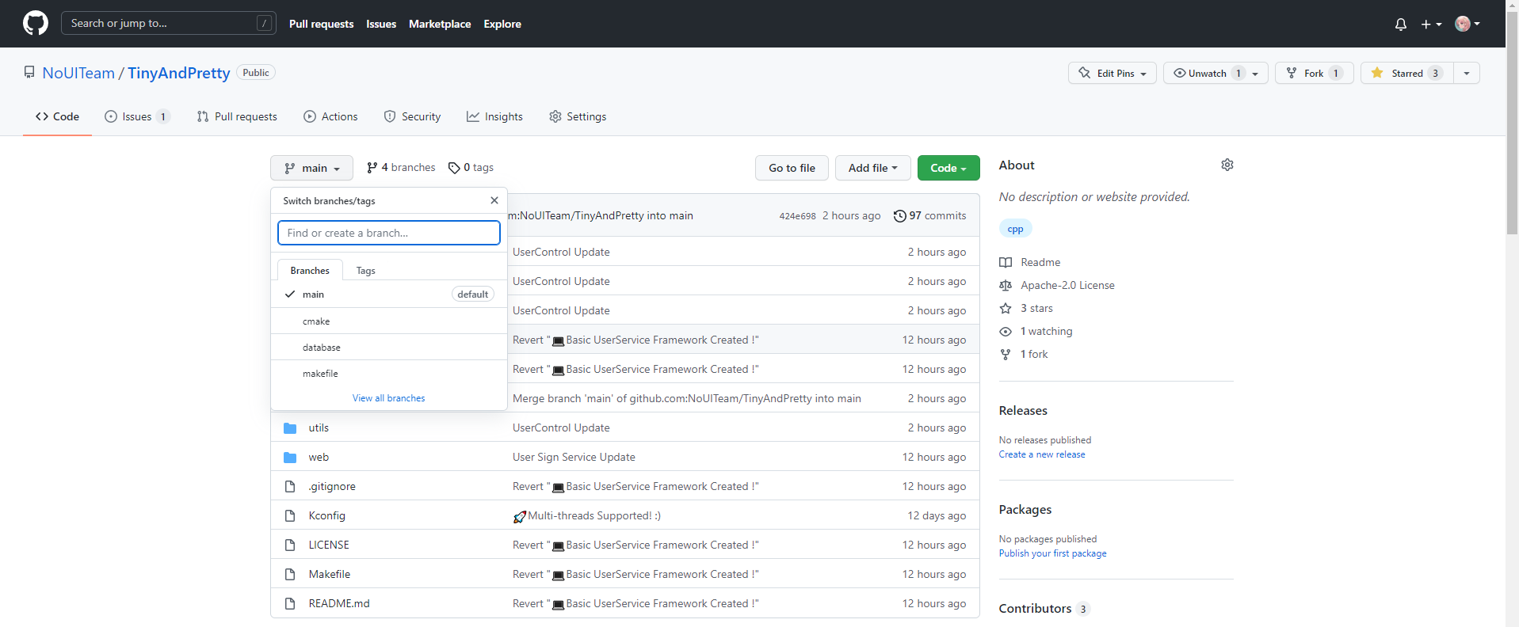
所有代码均托管到Github NoUITeam/TinyAndPretty (github.com)

Slide 9
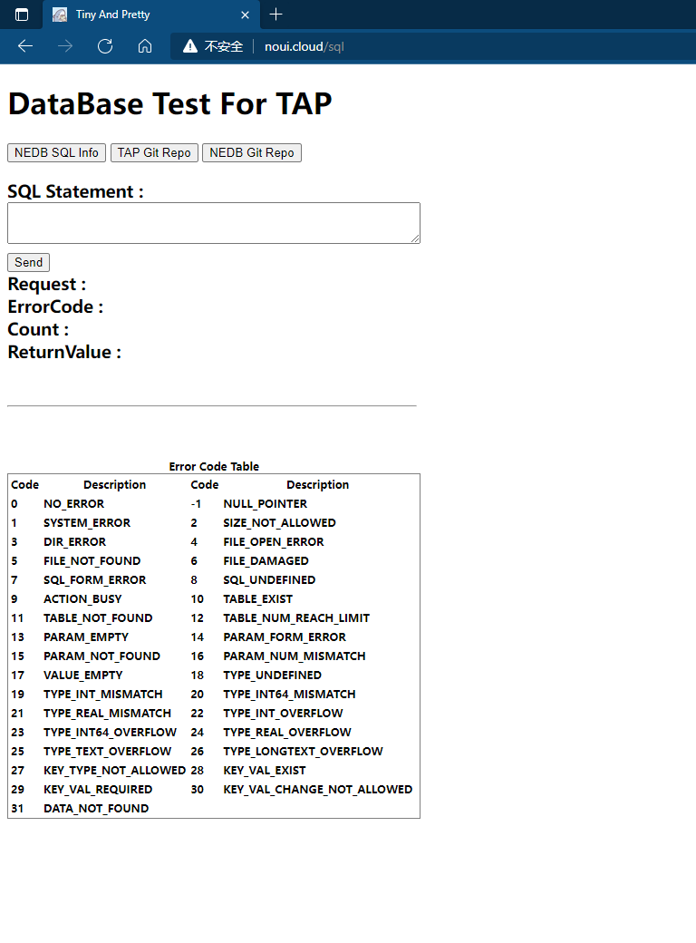
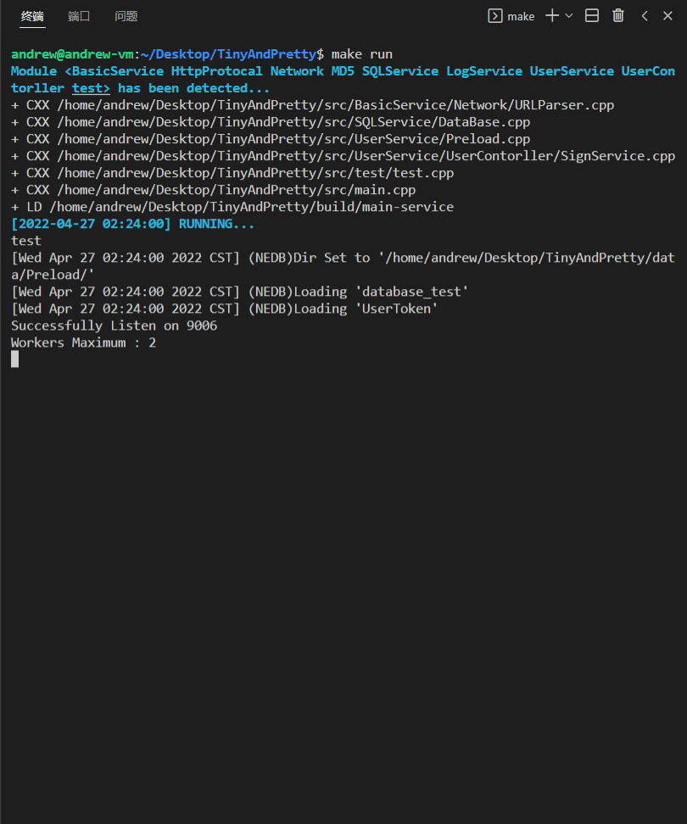
网站实机演示

Slide 10
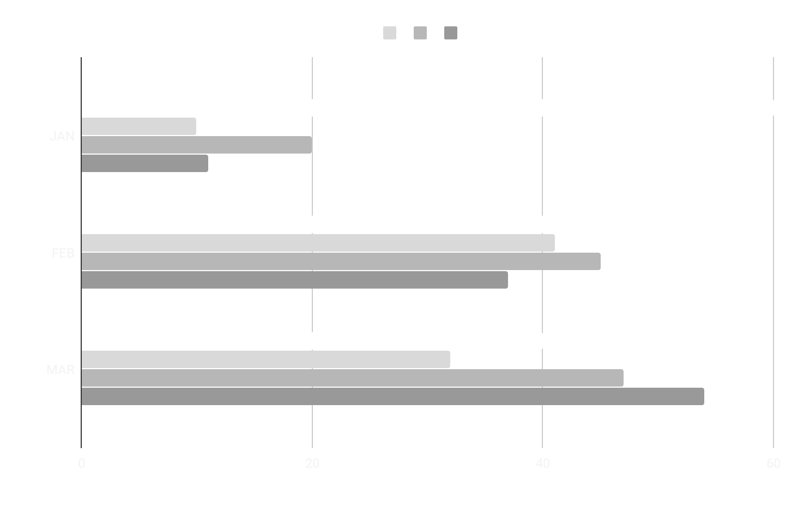
TO-DO List
MARS
MERCURY
VENUS
JUPITER
基础设施
B+Tree数据结构
SQL语言解析器
数据库并发控制
Reactor服务器
JSON构造模块
MD5算法
A*算法
业务处理
用户登录及权限处理
活动信息的CRUD
文件的数据与后台管理
现实地图的建模和演算
更美观的前端

Slide 11
03
项目未来规划
We determined to do in the near future

Slide 12
计划做但可能会砍掉的……
更好的日志系统
更令人惊讶的性能
更赏心悦目的前端
基于Skip-list、Lock-free的多线程日志库
基于用户时间一致性的原则，设计更好的内存Cache
Vue+ElementUI 大方、美观

Slide 13
THANKS
We are still working
第六小组 简旭峰 严云鹤 凌梓超
https://github.com/NoUITeam/TinyAndPretty

Slide 14
2nd ANNOUNCEMENT
MARS
Despite being red, Mars is a cold place
NEPTUNE
Neptune is the farthest planet from the Sun, the fourth-largest in our Solar System
JUPITER
SATURN
It’s the biggest planet in our Solar System
Saturn is composed of hydrogen

Slide 15
SECTOR NEWS
VENUS
MARS
SATURN
Despite being red, Mars is a cold place, not hot. It’s full of iron oxide dust, which gives the planet its reddish cast
Venus has a beautiful name and is the second planet from the Sun. It’s terribly hot, even hotter than the other planets
Yes, this is the ringed one. It’s a gas giant, composed mostly of hydrogen and helium. It’s named after the Roman god

Slide 16
NEWS
NEPTUNE
MARS
MERCURY
JUPITER
VENUS
SATURN
Neptune is the farthest planet from the Sun
Despite being red, Mars is actually a cold place
Mercury is the smallest one in the whole Solar System
Jupiter is the fourth-brightest in our Solar System
Venus has a beautiful name and is terribly hot as well
Yes, Saturn is the ringed planet. It’s a gas giant

Slide 17
CUSTOMER REVIEWS
RICHARD ROE
HELENA PATTERSON
“Neptune is the farthest planet from the Sun and the fourth-largest planet in our Solar System!”
“Despite being red, Mars is a cold place. It’s full of iron oxide dust, which gives the planet its reddish cast”

Slide 18
THIS IS A TABLE
 | ISSUE 1 | ISSUE 2 | ISSUE 3 | ISSUE 4
VENUS | 12 | 32 | 23 | 45
MERCURY | 67 | 23 | 45 | 65
MARS | 67 | 49 | 78 | 34

Slide 19
04
WELCOME!
You can enter here the subtitle if you need it

Slide 20

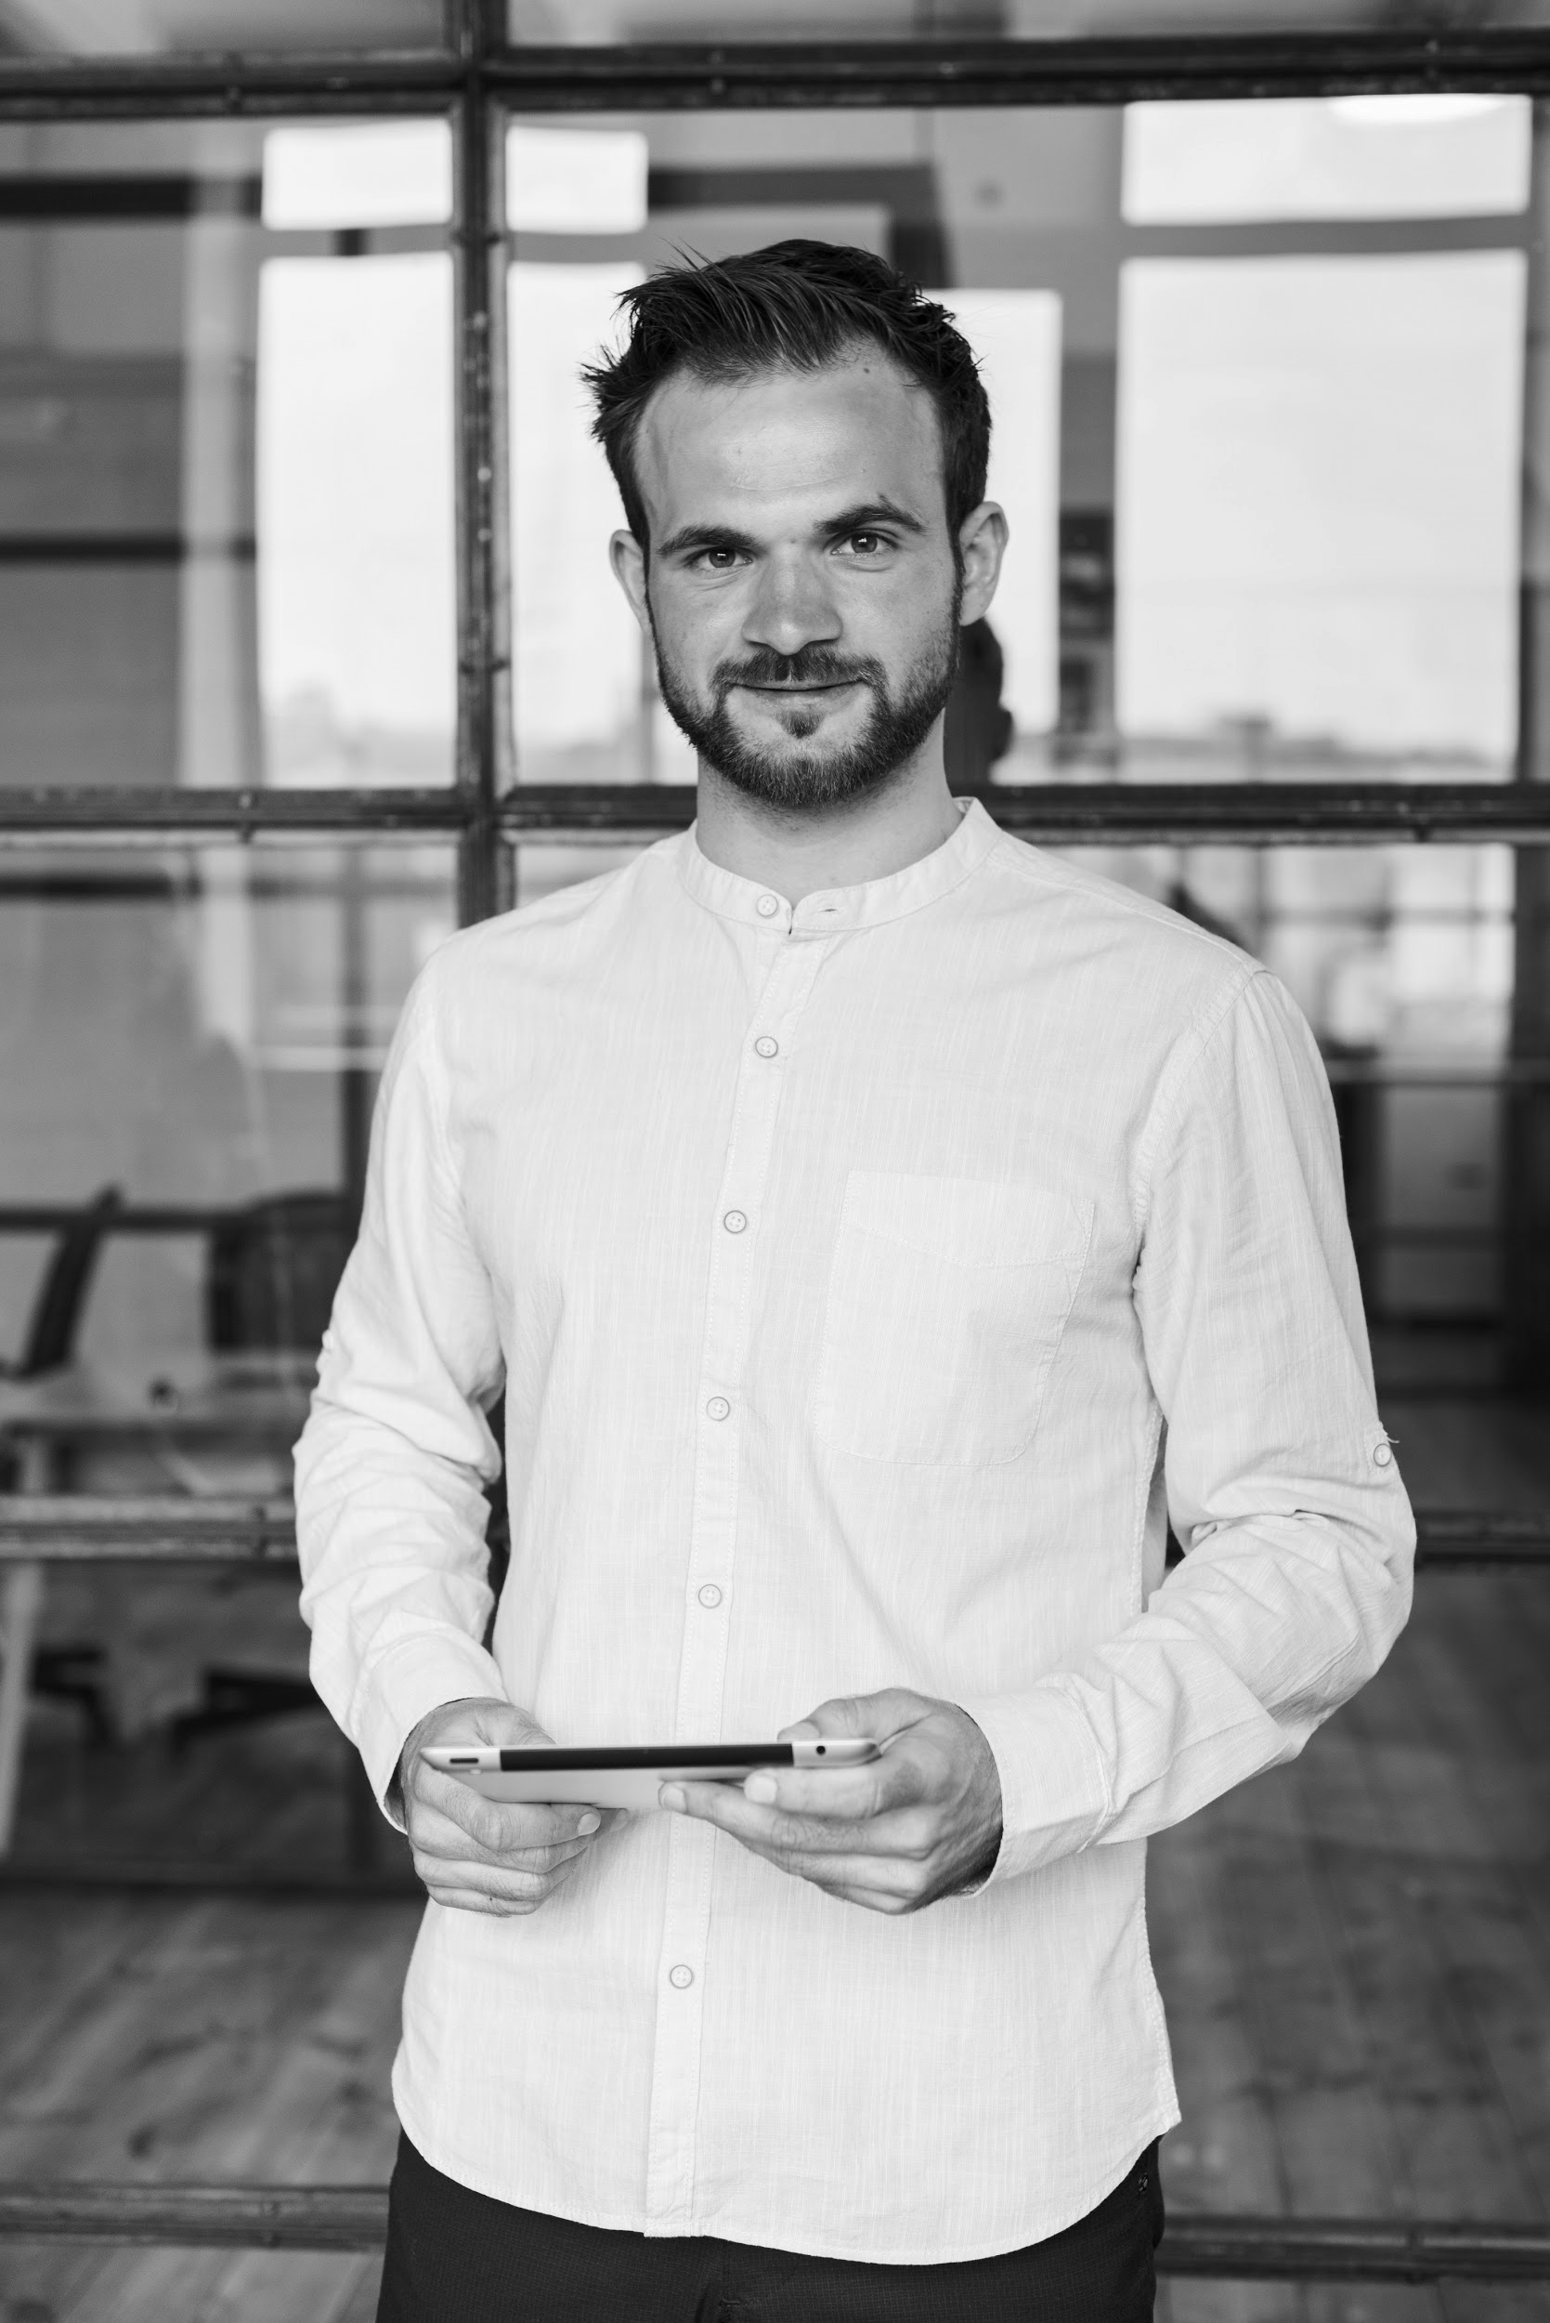
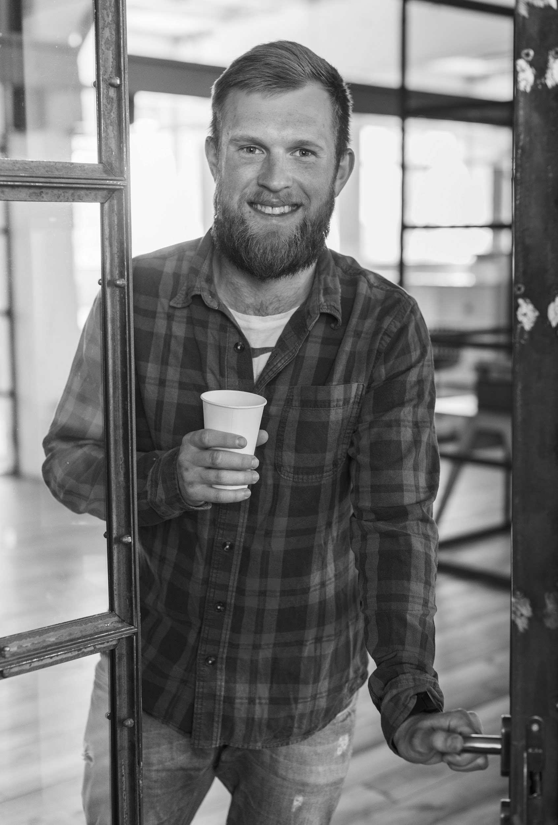

WELCOME!
MARY RUIZ
JOHN SMITH
JONATHAN DOE
MINA HAWKINS
Neptune is the farthest planet from the Sun and the fourth-largest
Despite being red, Mars is a cold place, not hot. It’s full of iron oxide dust
Mercury is the closest planet to the Sun and the smallest one
Venus has a beautiful name and is the second planet from the Sun

Slide 21
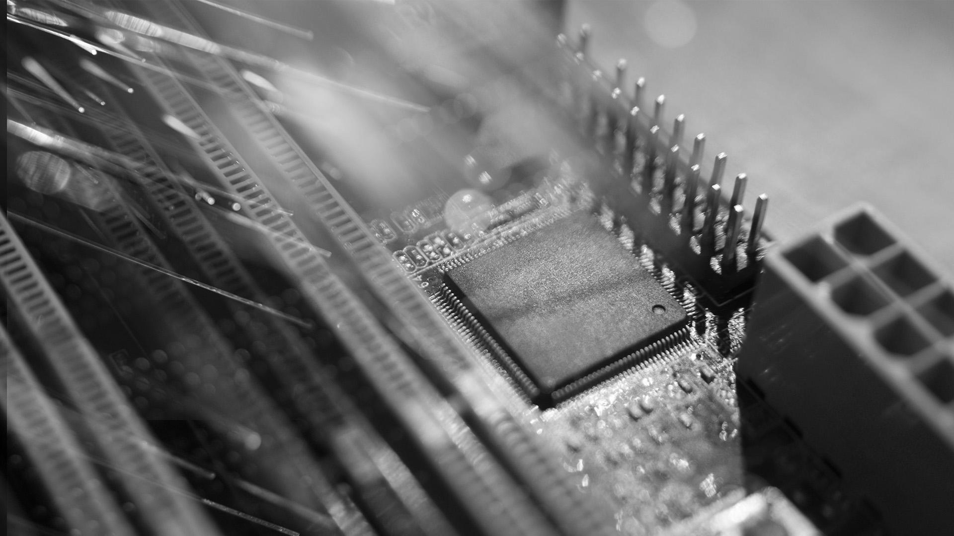
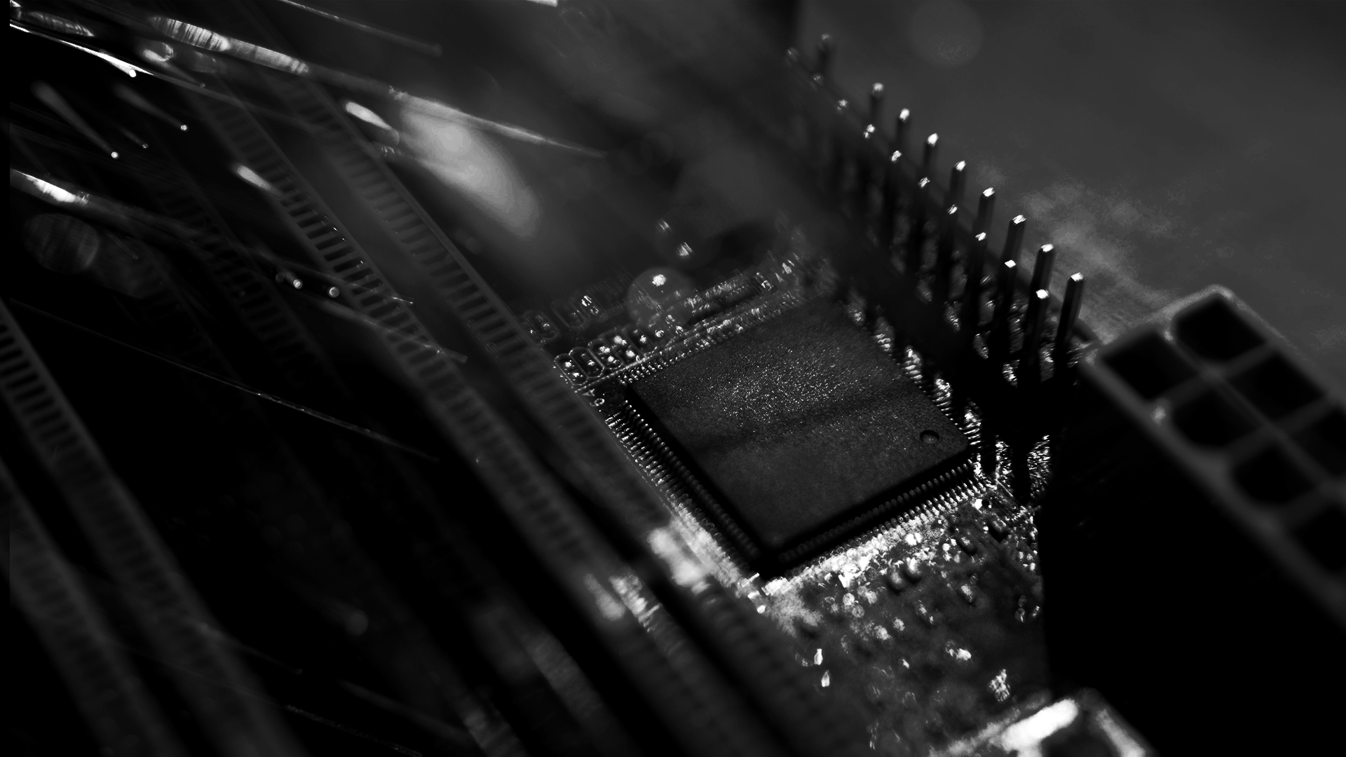
AWESOME WORDS

Slide 22
05
EVENTS
You can enter here the subtitle if you need it

Slide 23
REVIEW OF PAST EVENTS
Despite being red, Mars is a cold place, not hot
Jupiter is the biggest planet in our Solar System
FEB 02
APR 16
JAN 14
MAR 10
MAY 30
It is the closest planet to the Sun and the smallest
Saturn is composed of hydrogen and helium
Neptune is the farthest planet from the Sun

Slide 24
UPCOMING EVENTS
SEP 08
Mercury is the closest planet to the Sun
NOV 29
Saturn is composed of hydrogen
OCT 16
Despite being red, Mars is a cold place
DEC 10
Jupiter is the biggest planet in our Solar System

Slide 25
06
SNEAK PEEK
You can enter here the subtitle if you need it

Slide 26
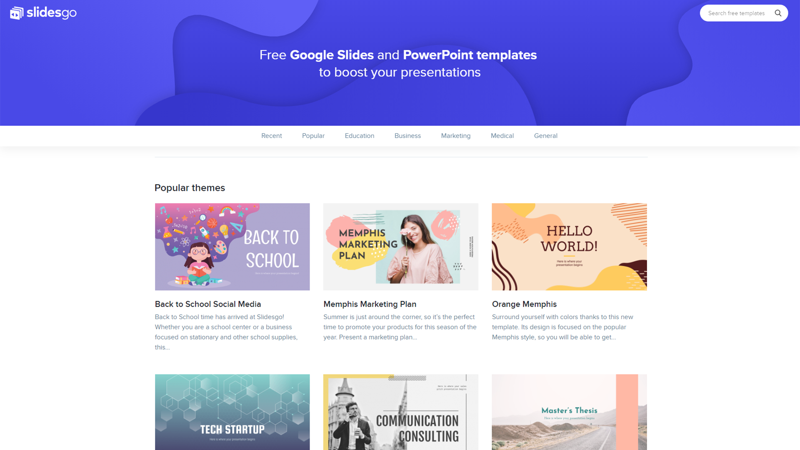
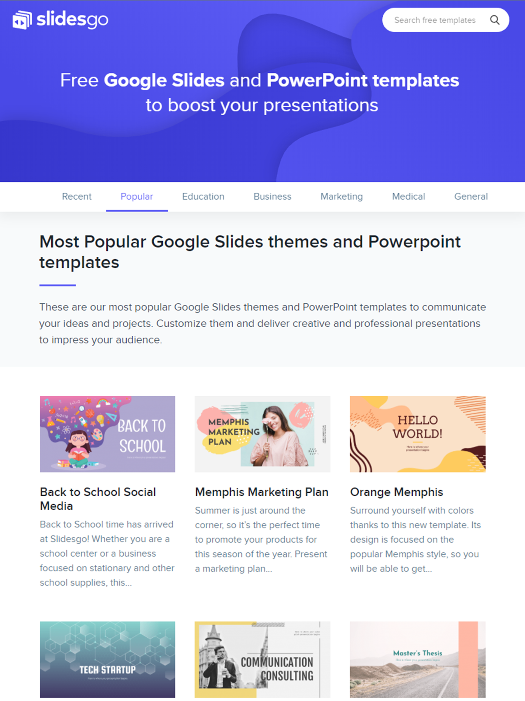
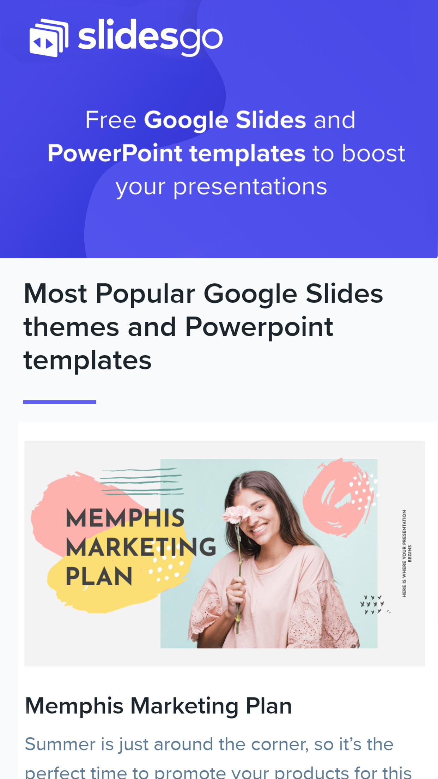
SNEAK PEEK
Neptune is the farthest planet from the Sun and the fourth-largest in our Solar System

Slide 27
RESOURCES
Did you like the resources on this template? Get them for free at our other websites.
PHOTOS
Woman using smartphone with hologram
Happy businesswoman looking at camera with holding pencil and diary
Portrait of smiling man holding digital tablet looking at camera
Smiling bearded man holding disposable coffee cup while opening door
Portrait of pretty woman holding laptop looking at camera
Motherboard with optical fiber
Futuristic technology screen interface
Front view of businessman holding high tech tablet
Businessman holding the newspaper and smiling
Multiracial group of cheerful coworkers
Happy young couple exchanging love messages
Smiling business people team sitting around the table in the meeting
VECTORS
Technology background with gradient colors
Blue 5g concept background
Abstract landing pages with technology devices
PREMIUM ICONS
Big Data Icon pack
PREMIUM PHOTOS
Short haired business woman laughing

Slide 28
Instructions for use
In order to use this template, you must credit Slidesgo by keeping the Credits slide.
You are allowed to:
- Modify this template.
- Use it for both personal and commercial projects.
You are not allowed to:
- Sublicense, sell or rent any of Slidesgo Content (or a modified version of Slidesgo Content).
- Distribute Slidesgo Content unless it has been expressly authorized by Slidesgo.
- Include Slidesgo Content in an online or offline database or file.
- Offer Slidesgo templates (or modified versions of Slidesgo templates) for download.
- Acquire the copyright of Slidesgo Content.
For more information about editing slides, please read our FAQs or visit Slidesgo School:
https://slidesgo.com/faqs and https://slidesgo.com/slidesgo-school

Slide 29
Fonts & colors used
This presentation has been made using the following fonts:
Exo 2
(https://fonts.google.com/specimen/Exo+2)
Roboto Condensed
(https://fonts.google.com/specimen/Roboto+Condensed)
#434343
#eeeeee
#ffffff

Slide 30





Stories by Freepik
Create your Story with our illustrated concepts. Choose the style you like the most, edit its colors, pick the background and layers you want to show and bring them to life with the animator panel! It will boost your presentation. Check out How it Works.
Pana
Amico
Bro
Rafiki
Cuate

Slide 31
Use our editable graphic resources...
You can easily resize these resources without losing quality. To change the color, just ungroup the resource and click on the object you want to change. Then, click on the paint bucket and select the color you want. Group the resource again when you’re done. You can also look for more infographics on Slidesgo.

Slide 34
JANUARY
FEBRUARY
MARCH
APRIL
MAY
JUNE
PHASE 1
Task 1
Task 2
PHASE 2
Task 1
Task 2
JANUARY
FEBRUARY
MARCH
APRIL
PHASE 1
Task 1
Task 2

Slide 37
...and our sets of editable icons
You can resize these icons, keeping the quality.
You can change the stroke and fill color; just select the icon and click on the paint bucket/pen.
In Google Slides, you can also use Flaticon’s extension, allowing you to customize and add even more icons.

Slide 38
Educational Icons
Medical Icons

Slide 39
Business Icons
Teamwork Icons

Slide 40
Help & Support Icons
Avatar Icons

Slide 41
Creative process Icons
Performing Arts Icons

Slide 42
Nature Icons

Slide 43
SEO & Marketing Icons

Slide 44


